Slide 1
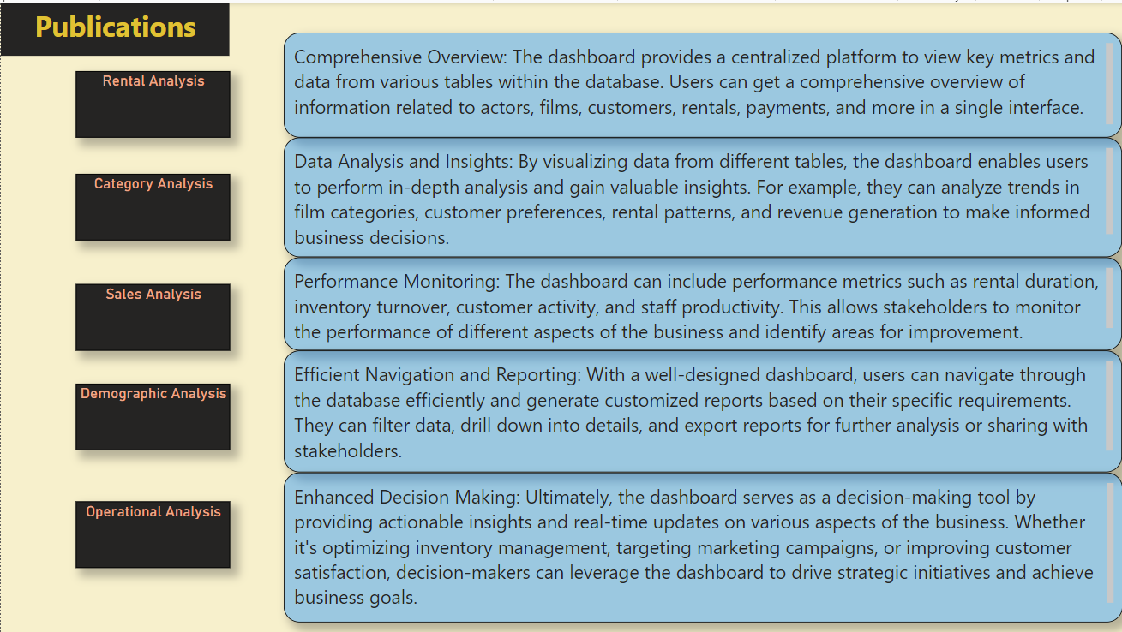

Slide 2
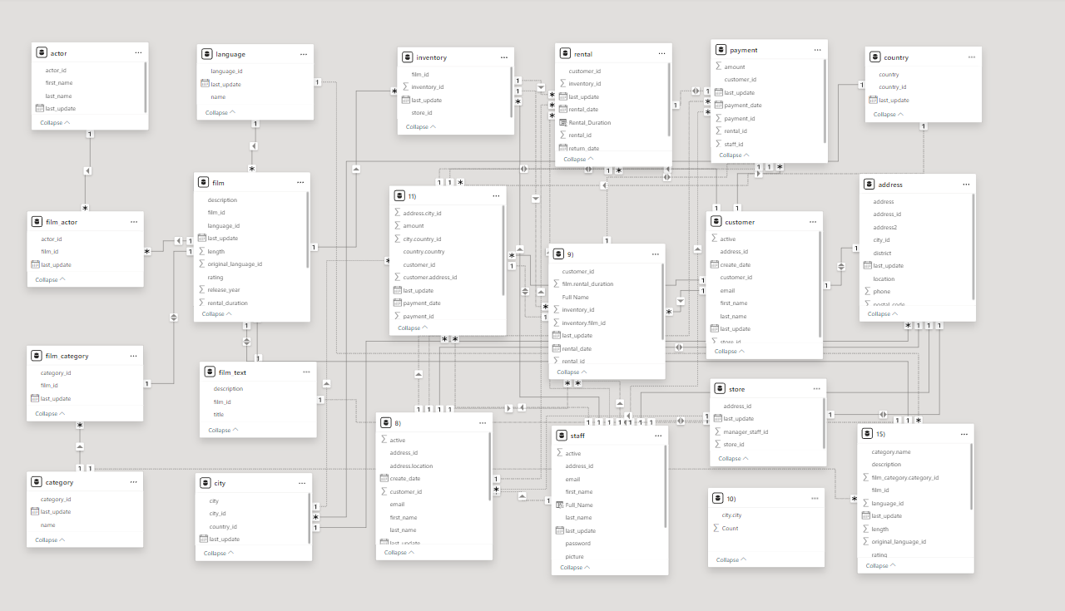

ER DIAGRAM

Slide 3
POWER BI PROBLEM STATEMENTS

Slide 4
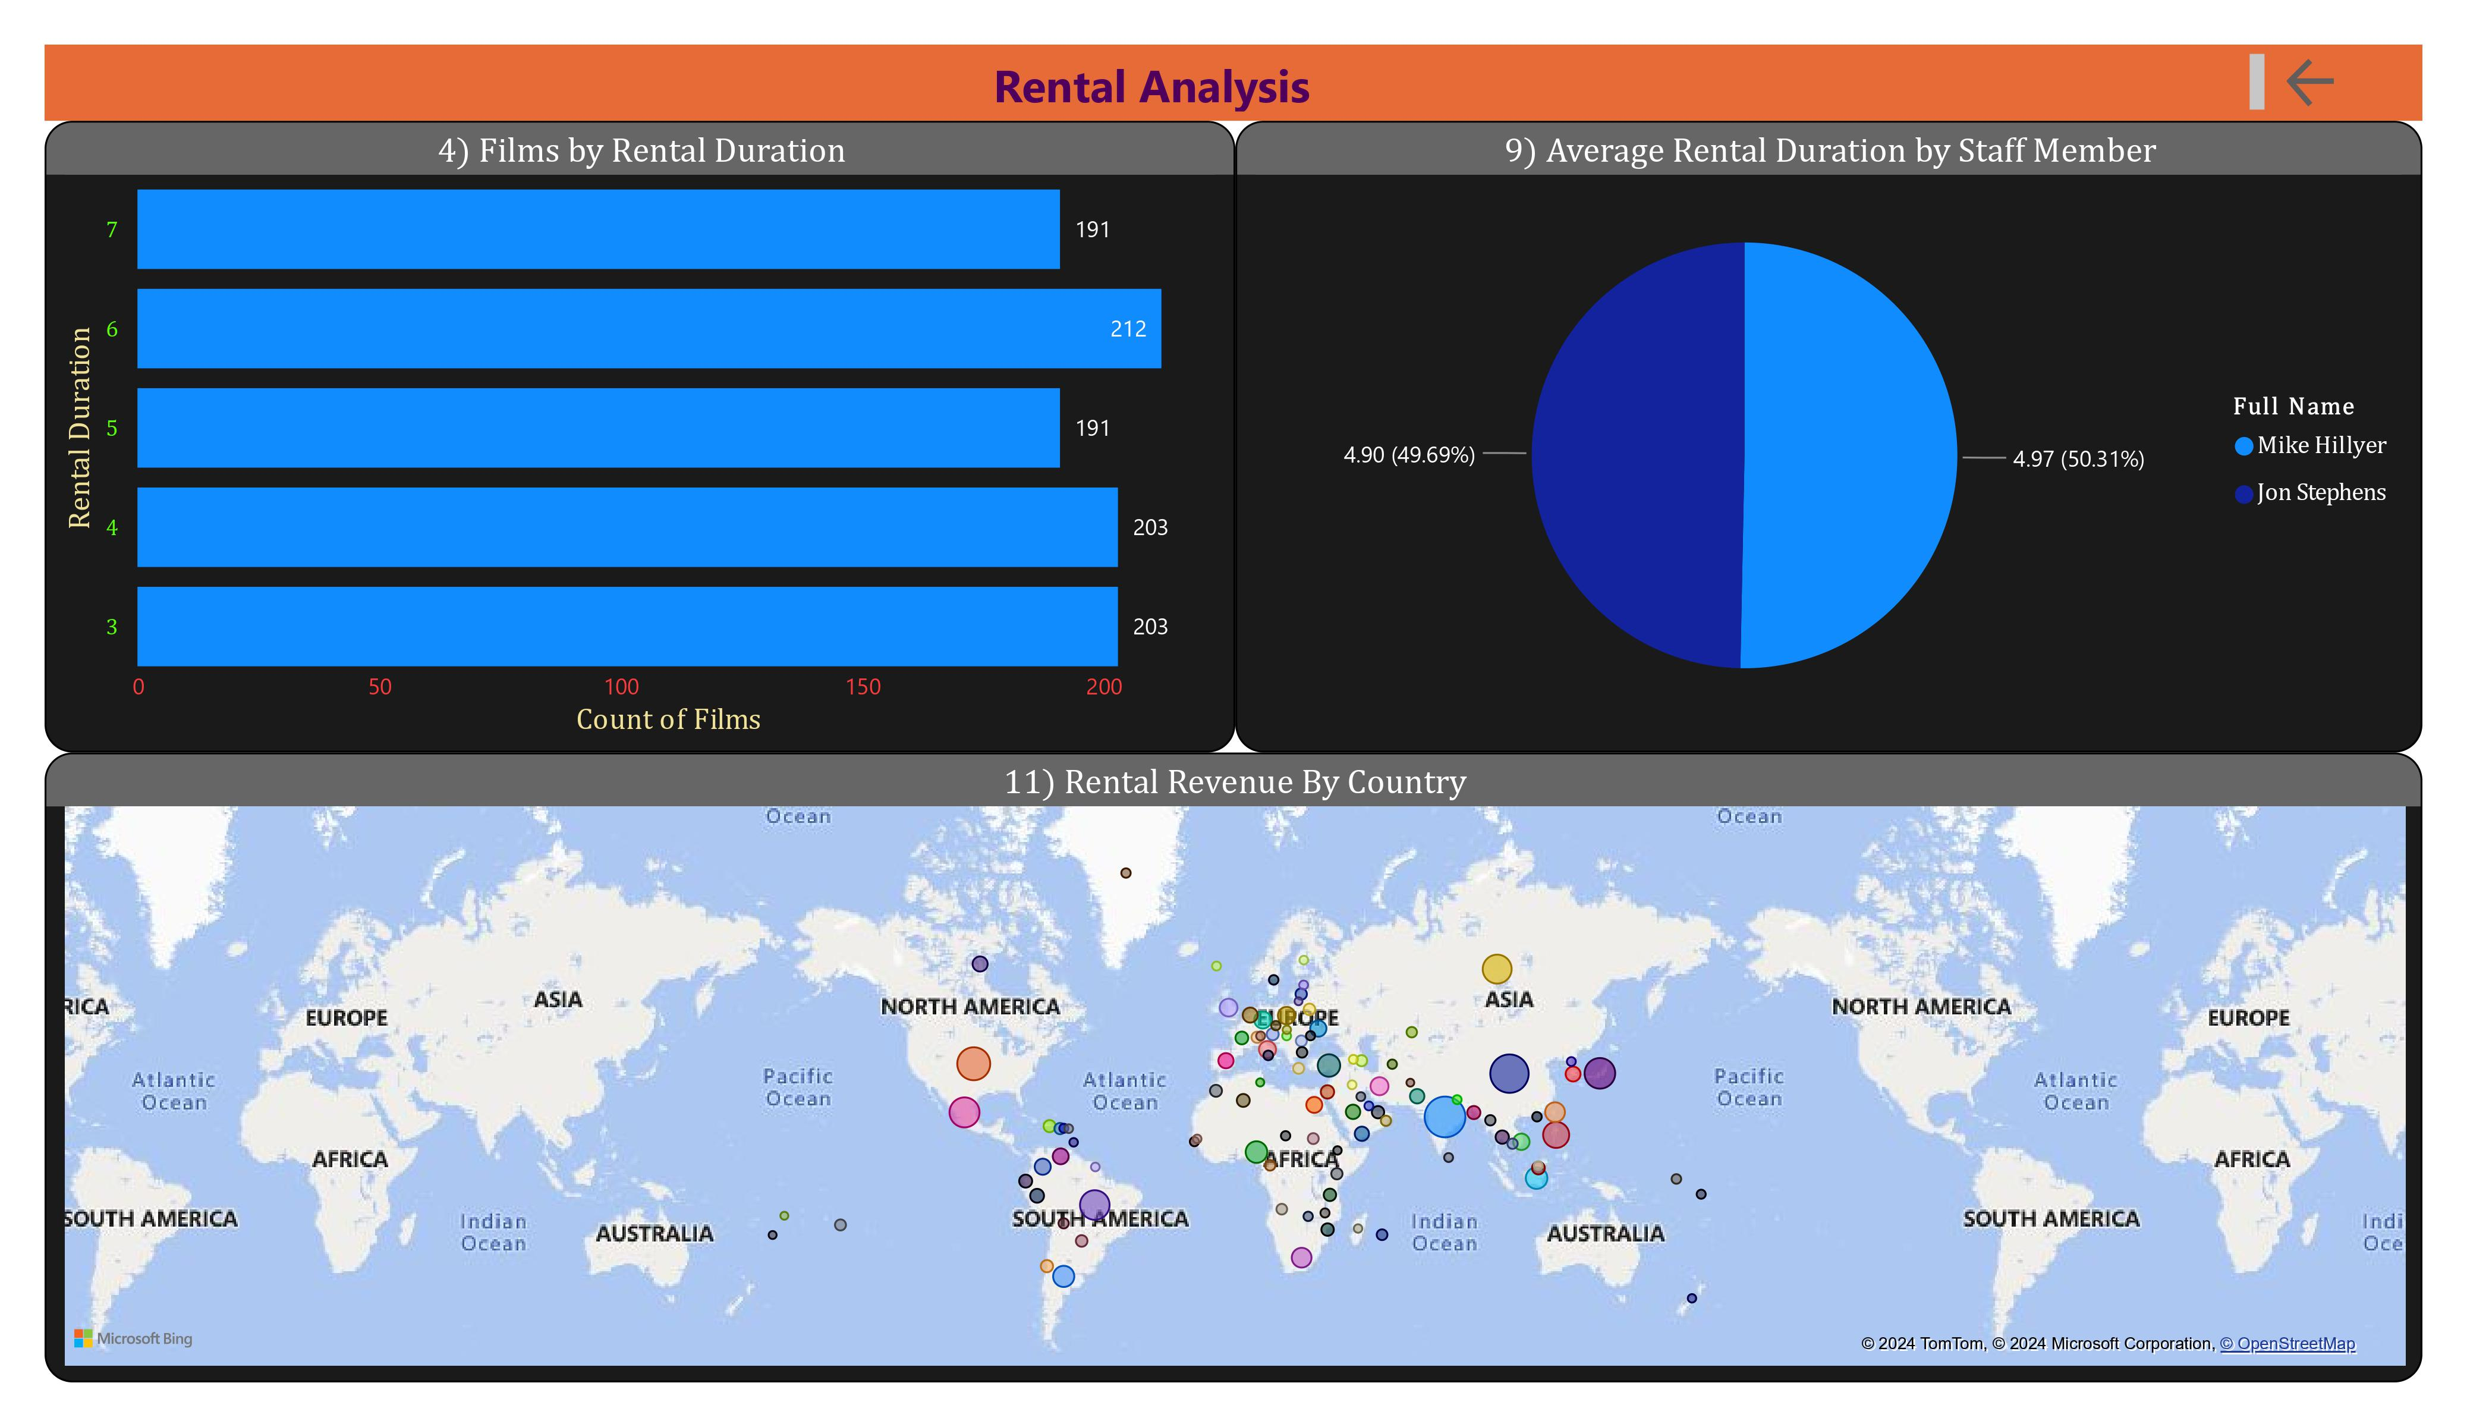

Slide 5
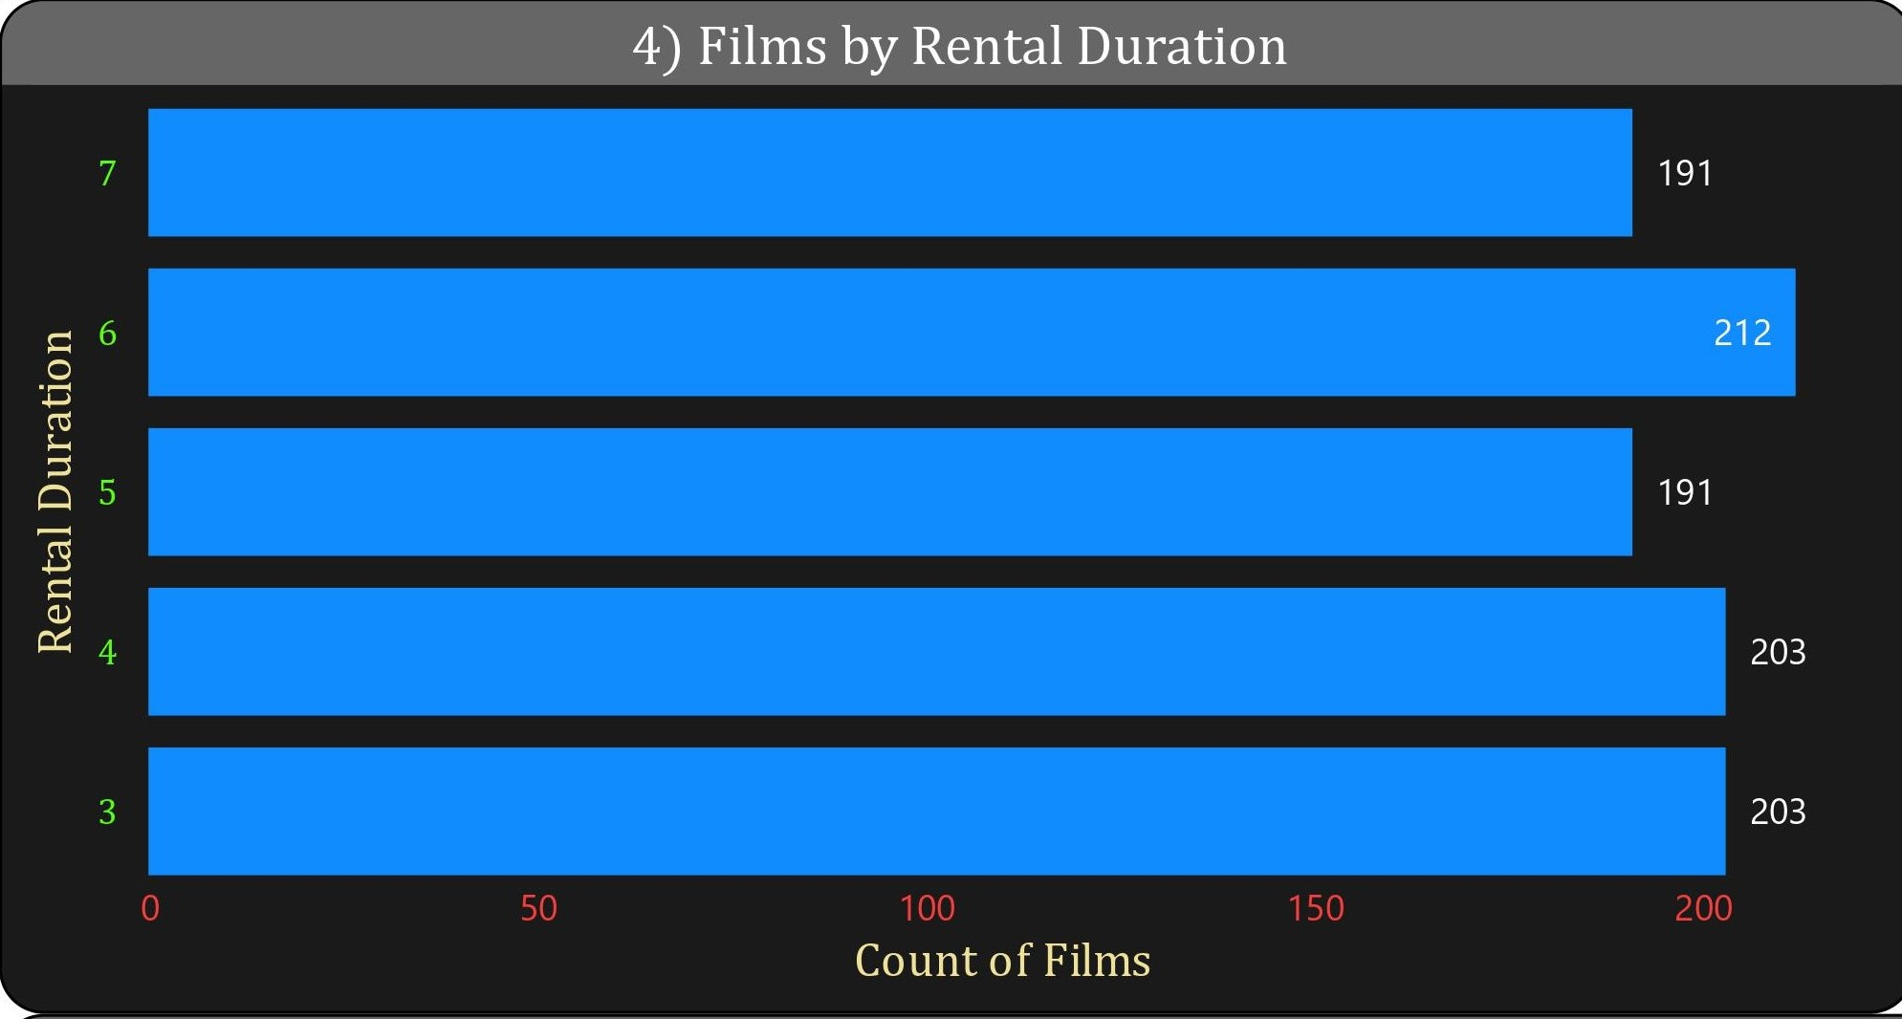
4) What is the distribution of films by rental duration?
Solution - After analyzing the visualization, we can conclude that the highest distribution of films by rental duration is for 6 days, while the lowest is for 7 and 5 days. For 4 and 3 days, it was moderate.

Slide 6
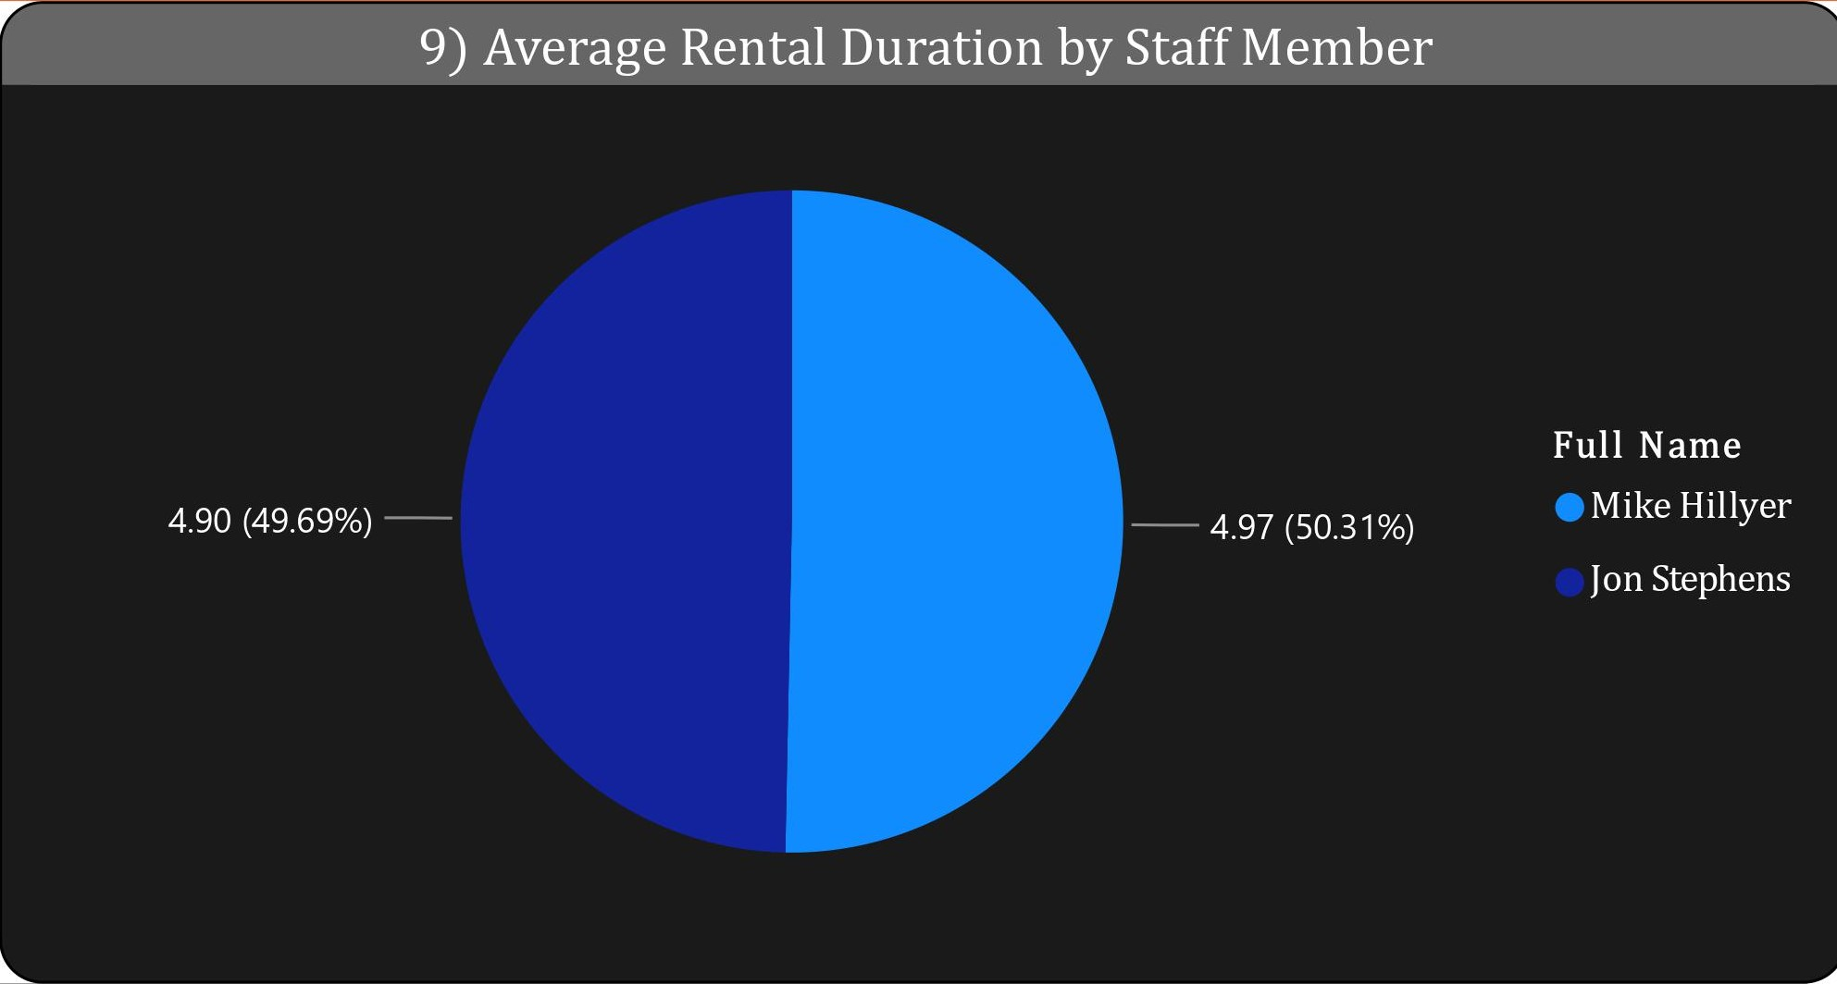
9) What is the average rental duration by staff member?
Solution - From the visualization, it is evident that both staff members are selling rentals with similar average rental durations. Mike Hilyer is having 50.31% and Jon Stephens is having 49.69%

Slide 7
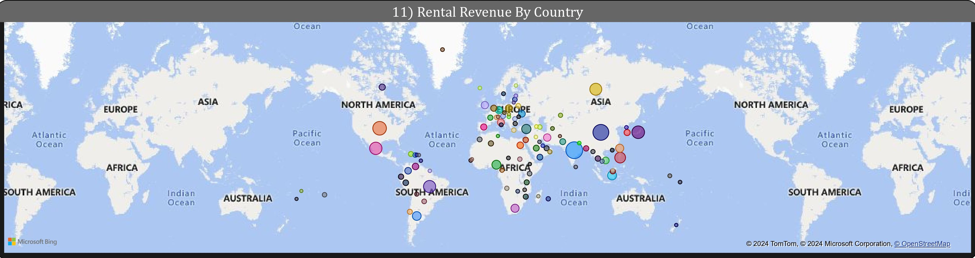
11) How does the rental revenue vary by country?
Solution - There is no column labeled "revenue" in the provided tables. Therefore, the amount paid in the payment table is considered as revenue, and the variation is depicted in the map above.

Slide 8
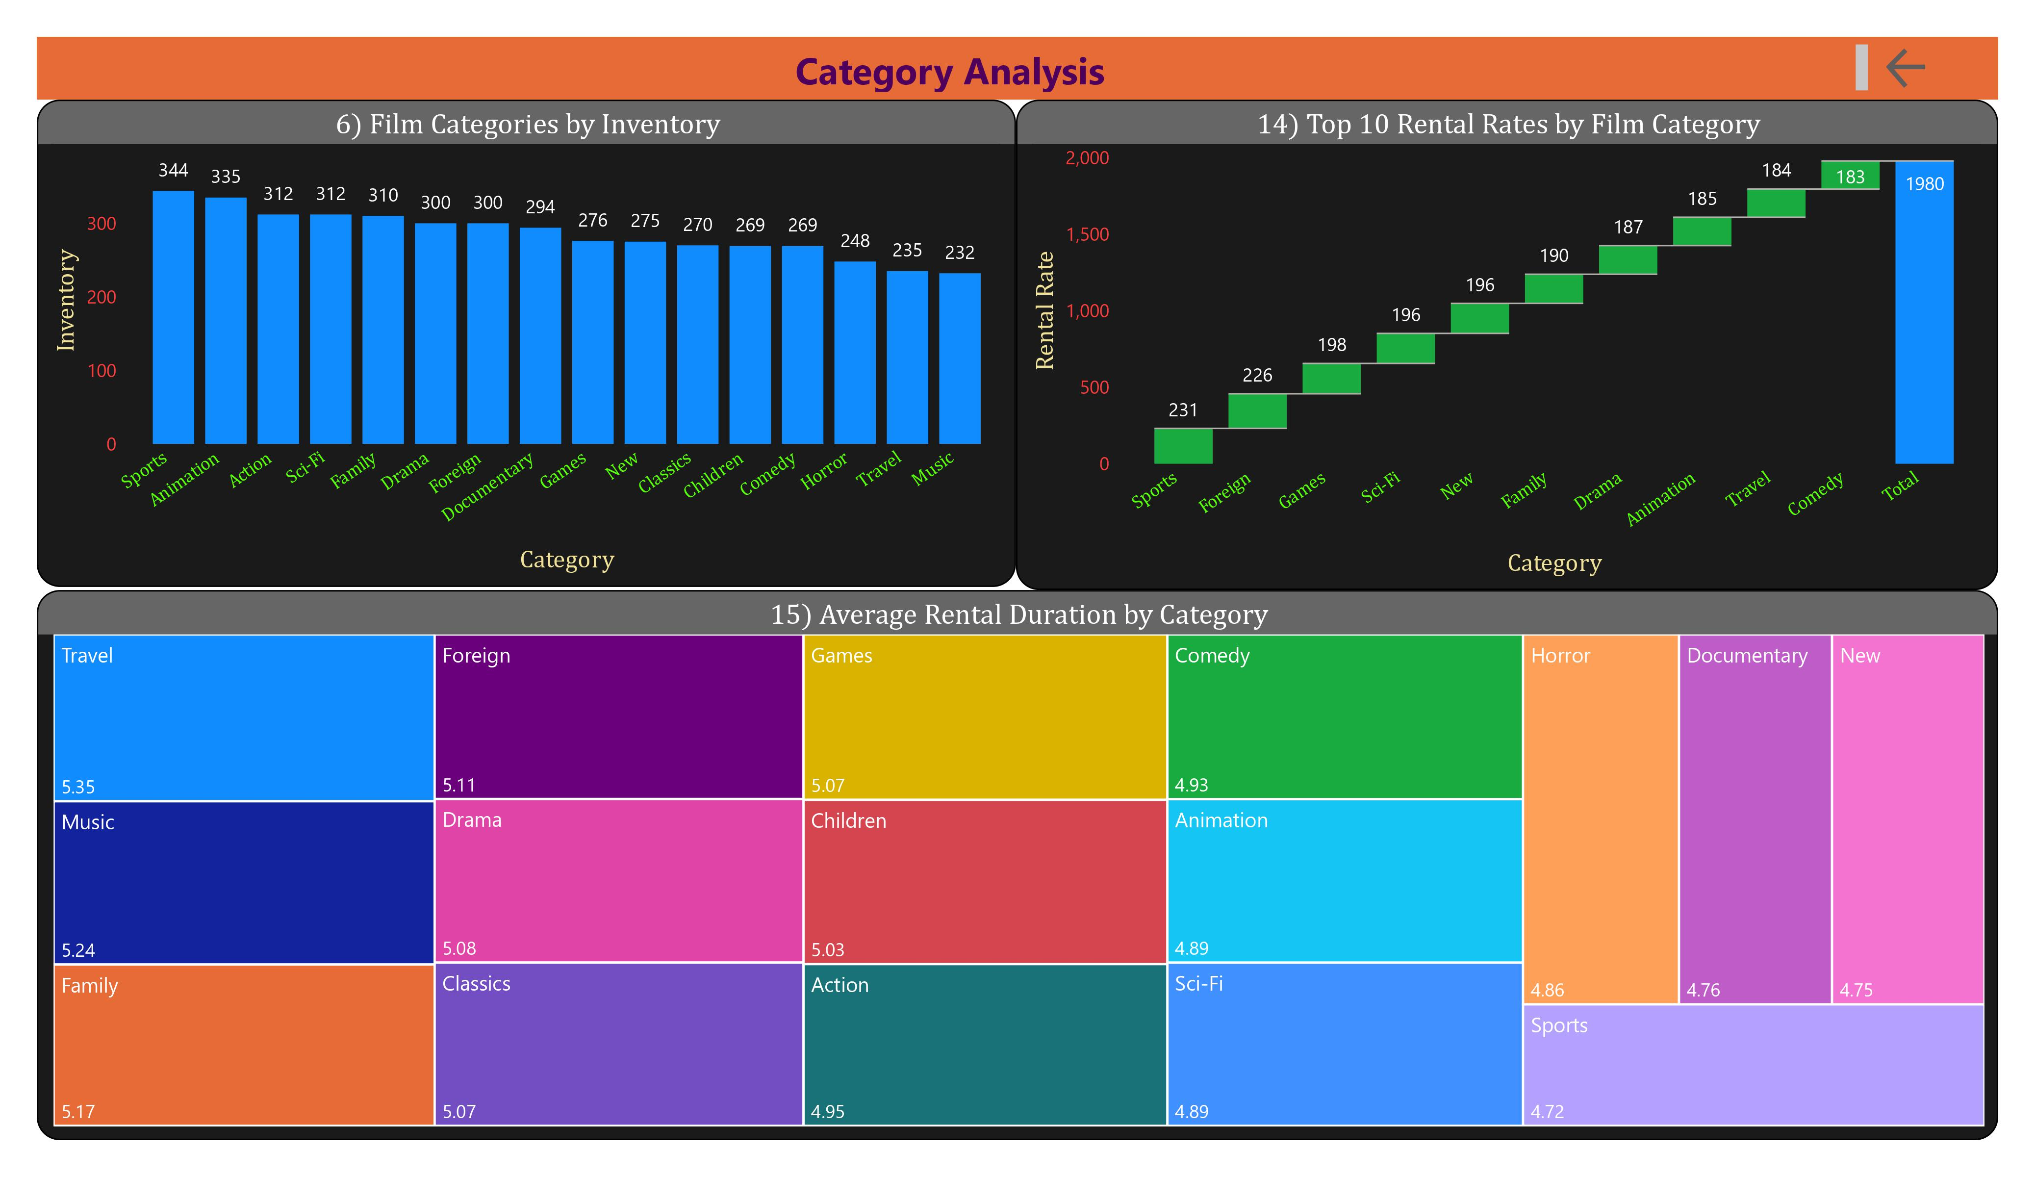

Slide 9
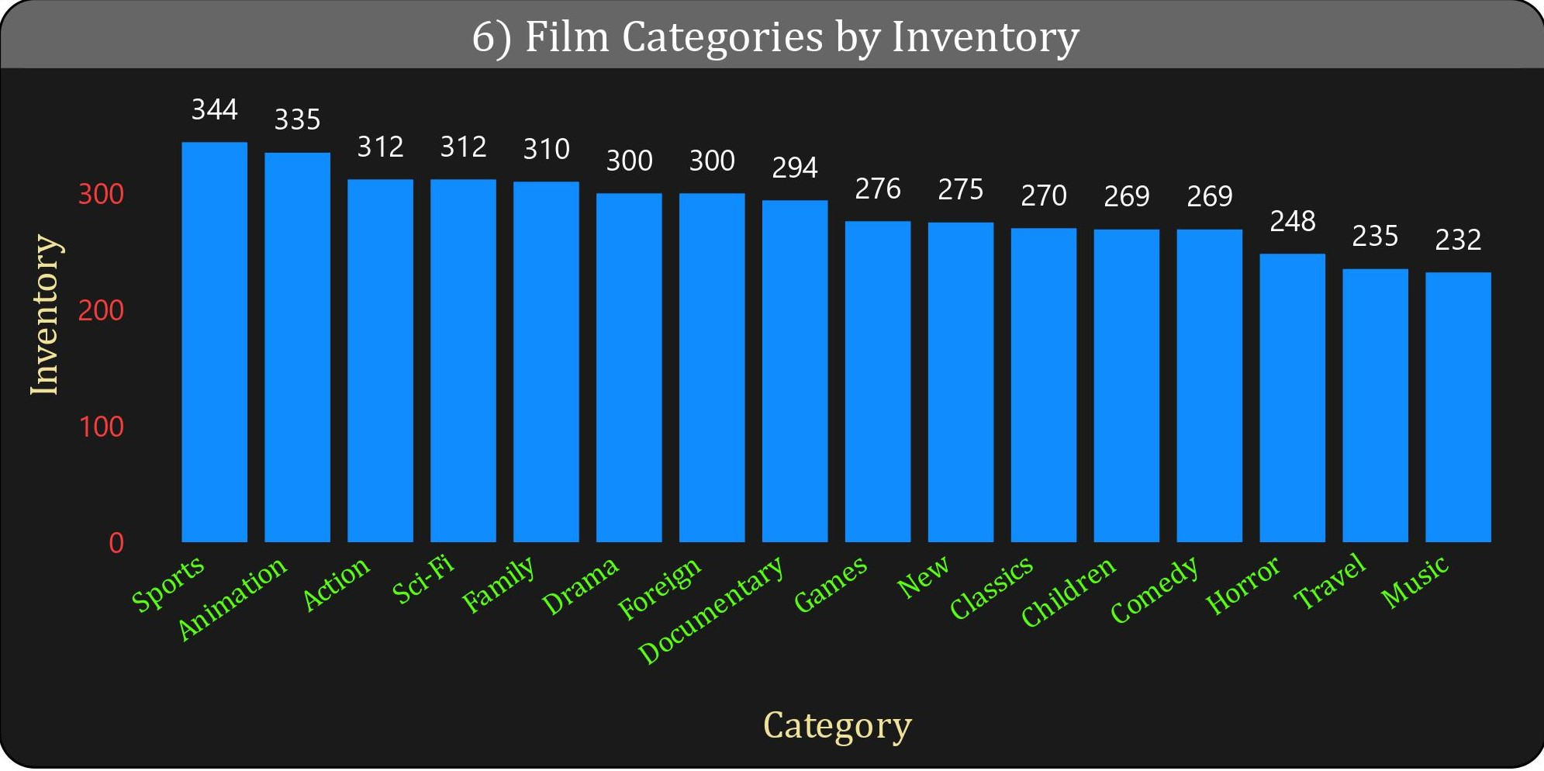
6) What is the breakdown of film categories in the inventory?
Solution -
From the visualization, we can conclude that the sports category has a greater number of inventory items compared to others, while the music category has fewer inventory items.

Slide 10
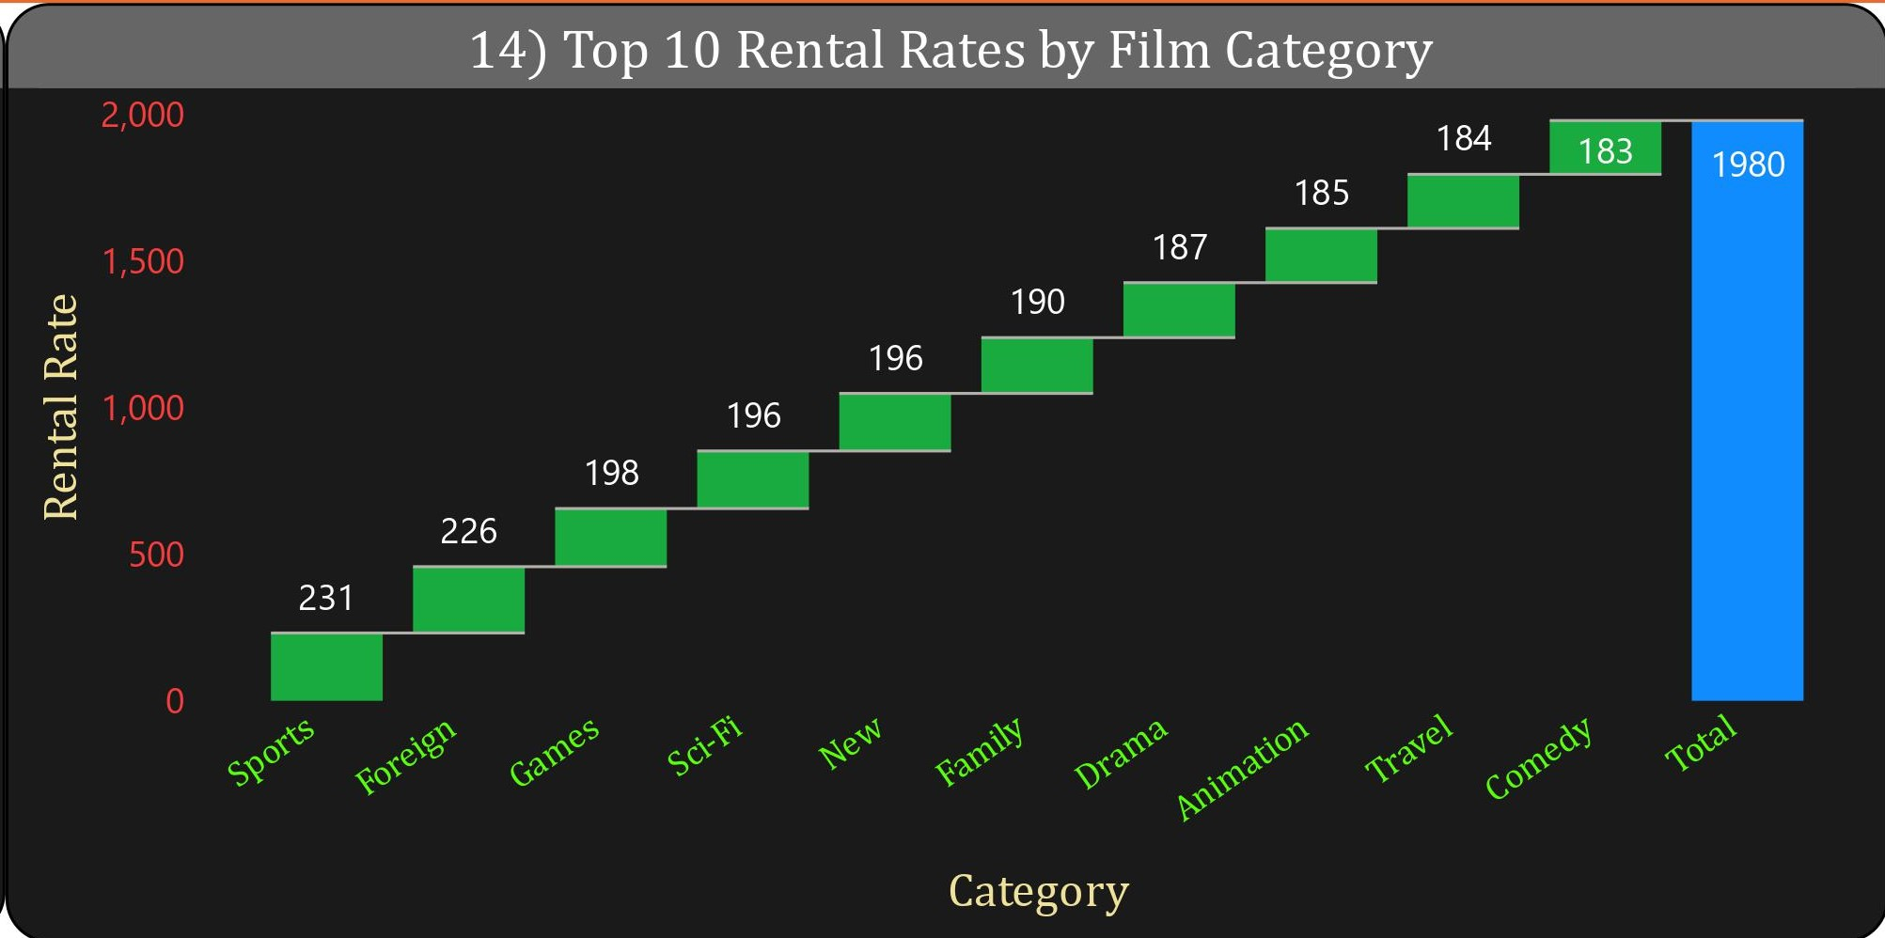
14) Which film categories have the highest rental rates?
Solution -
From the visualization, the categories with the highest rental rates are sports, foreign, games, sci-fi, new, family, drama, animation, travel, and comedy, with comedy having the highest rental rate.

Slide 11
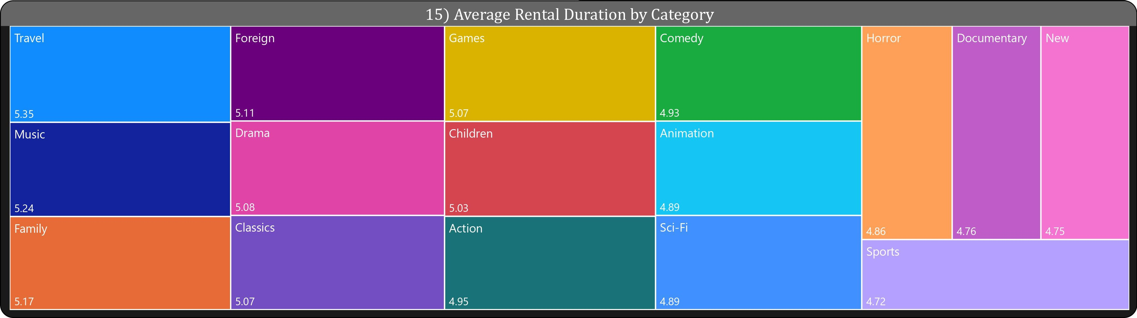
15) How does the average rental duration vary by film category?
Solution - From the above visualization, travel has the highest average rental duration, while sports has the lowest average rental duration.

Slide 12
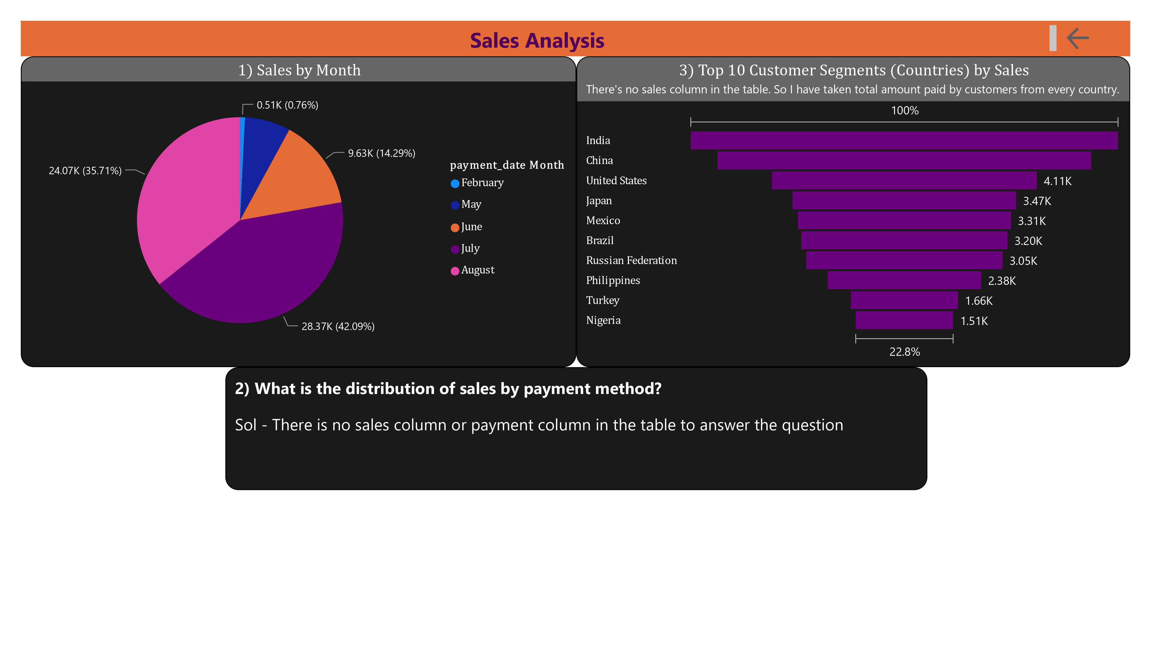

Slide 13
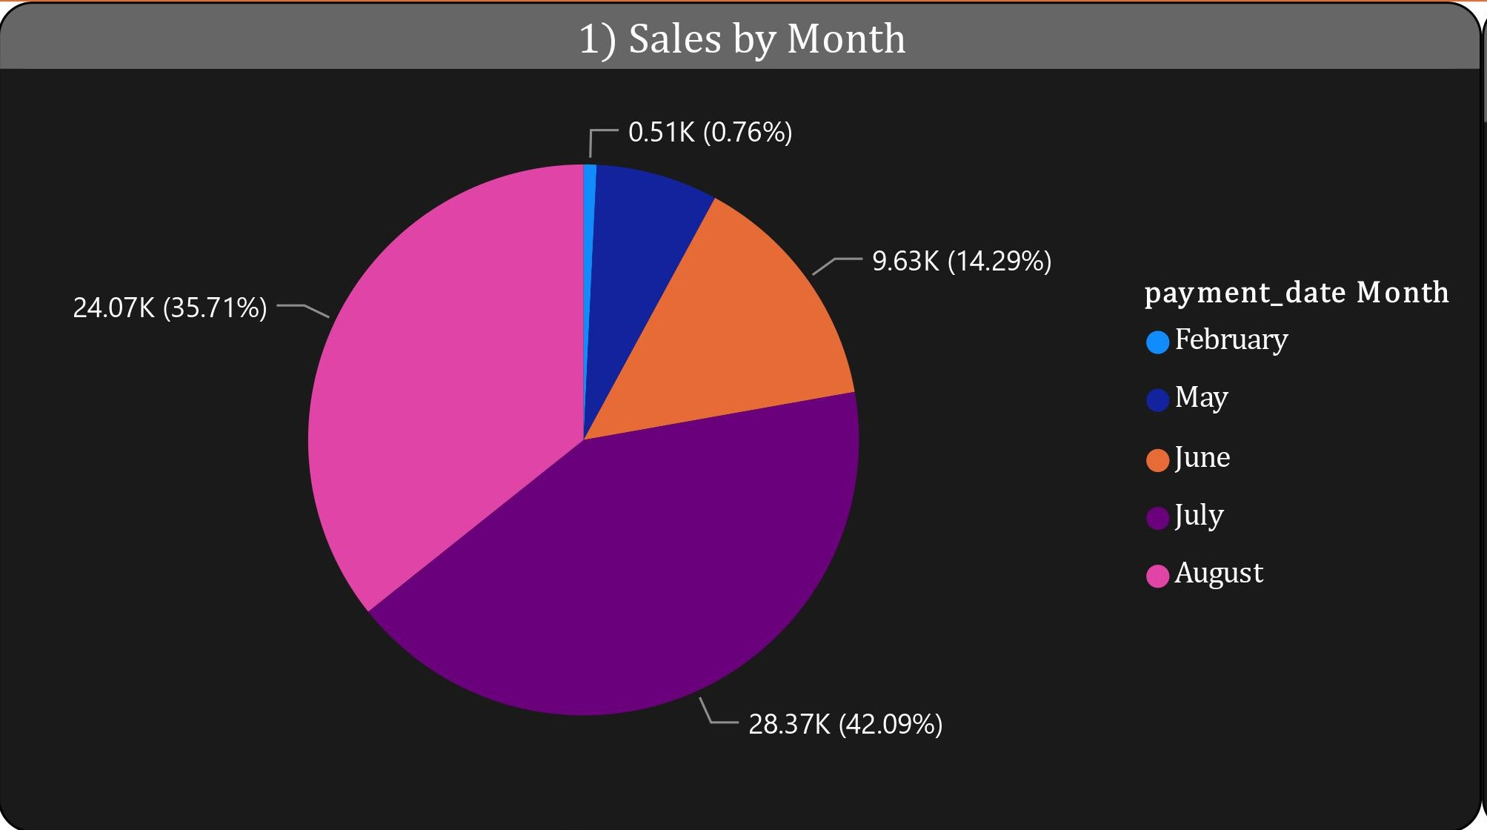
1) How does the sales revenue vary by month?
Solution -
There is no column labeled "sales" in the table. Therefore, the amount paid by customers is considered as sales. Hence, from the above visualization, we find July as the highest selling month and February as the lowest selling month.

Slide 14
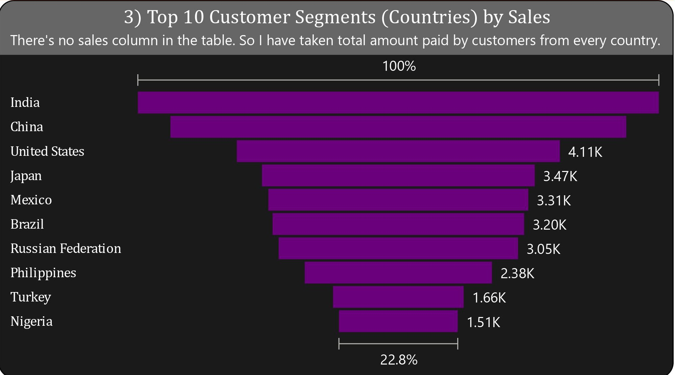
3) Which customer segments generate the highest sales?
Solution -
There is no column labeled "sales" in the table. Therefore, the amount paid by customers is considered as sales. After considering country as a segment, we can conclude that India has the highest sales within the highest-selling segments.

Slide 15
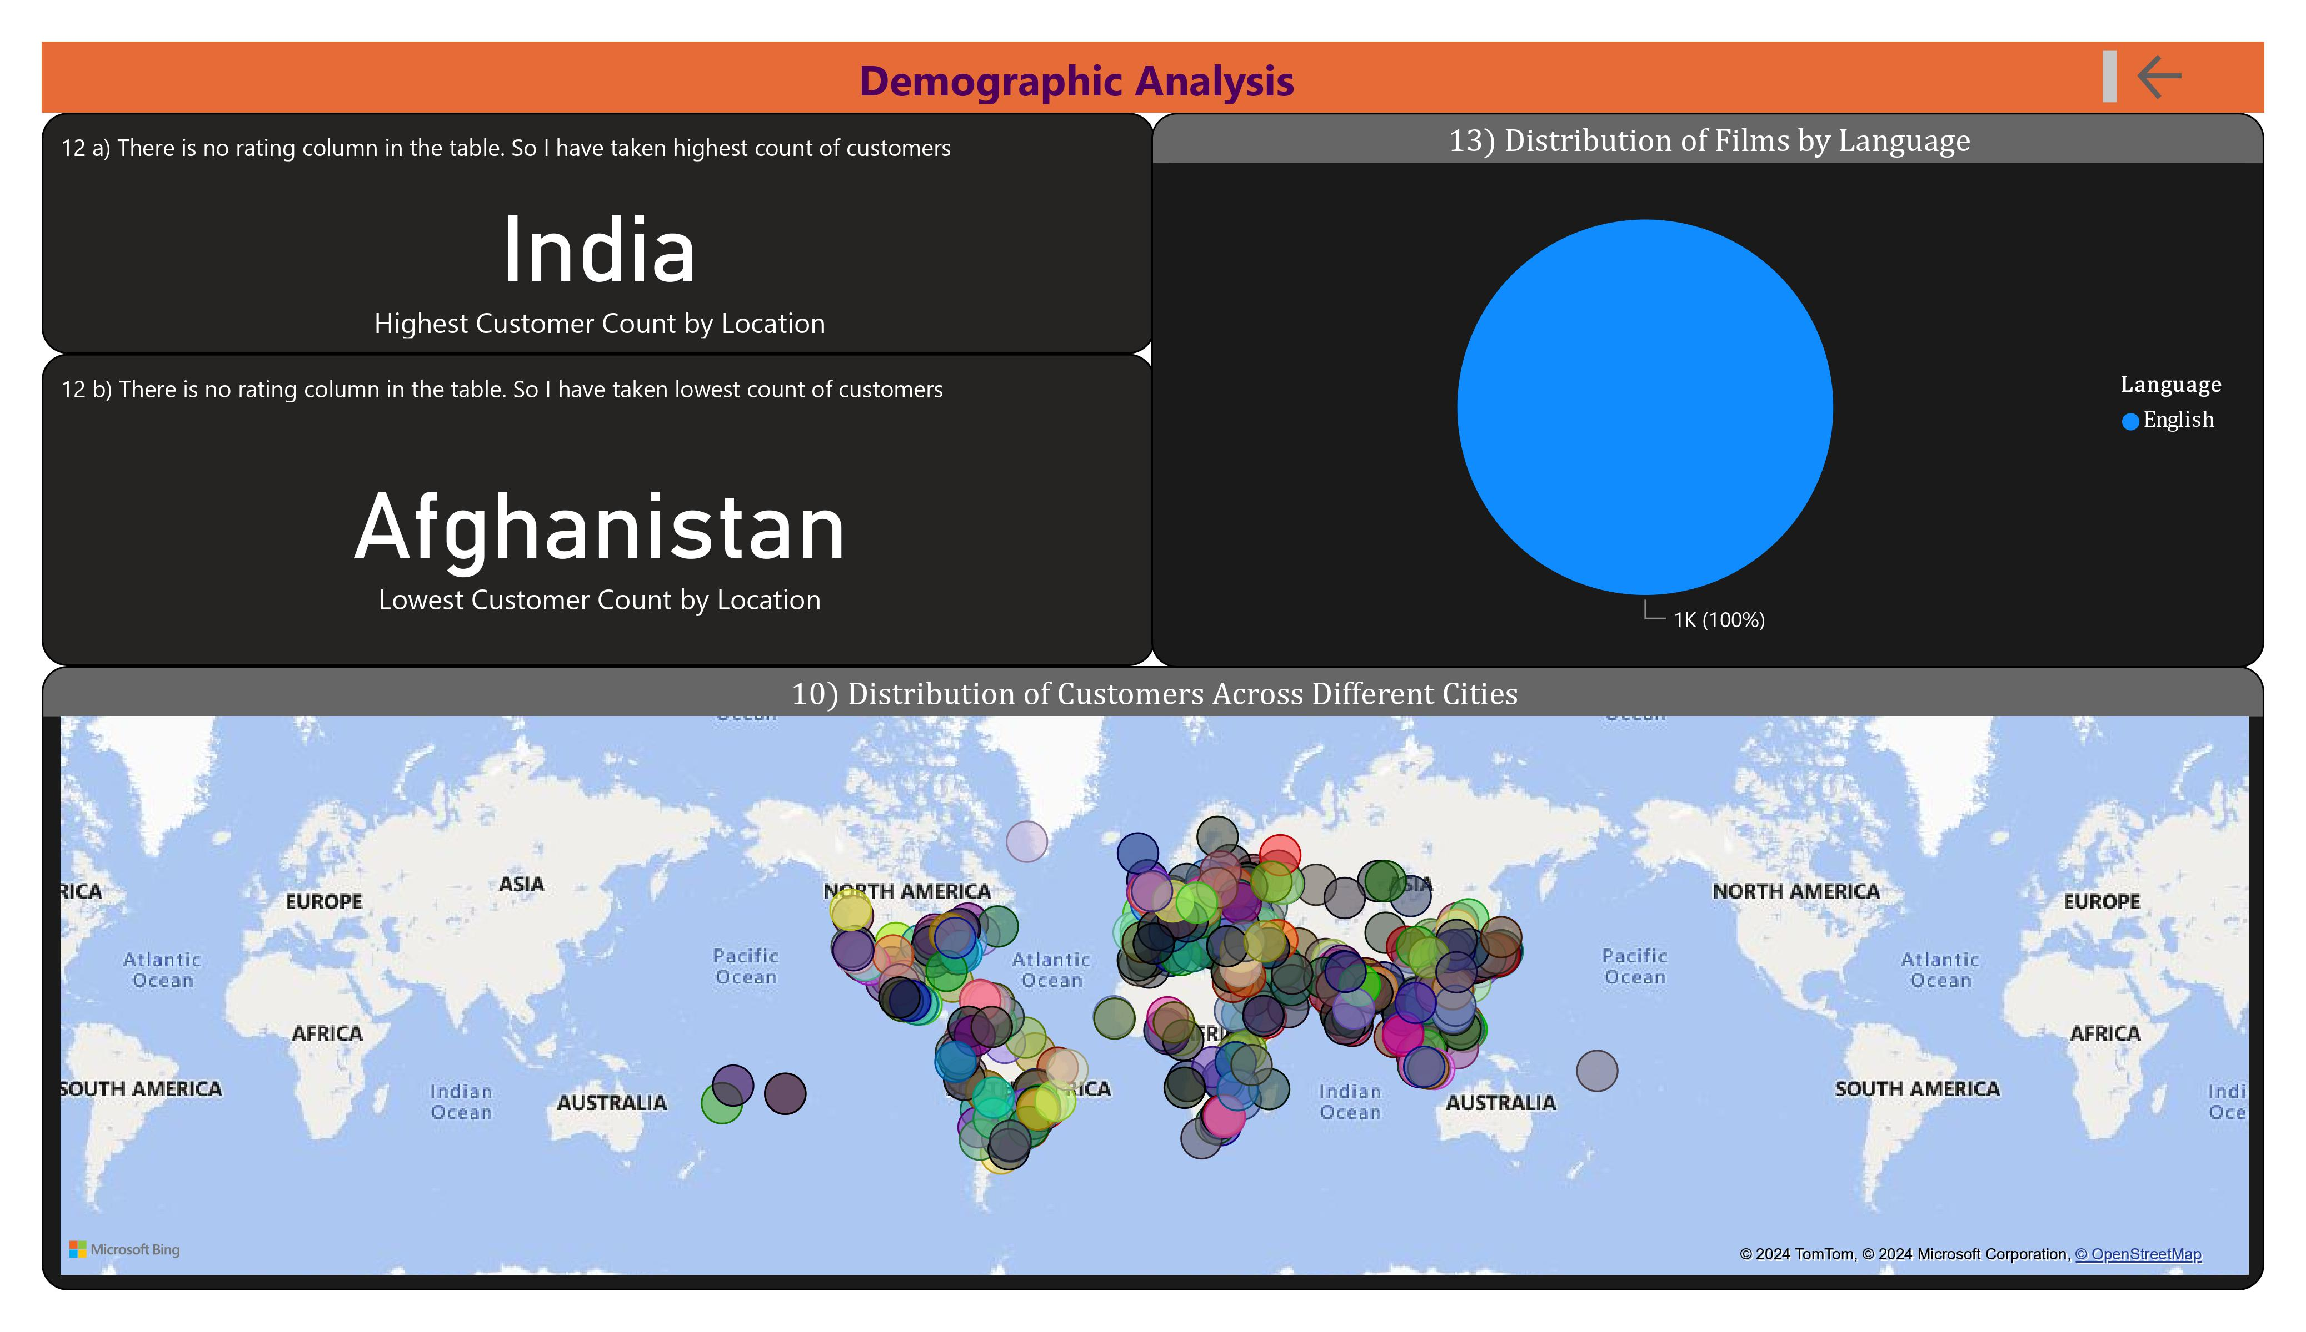

Slide 16
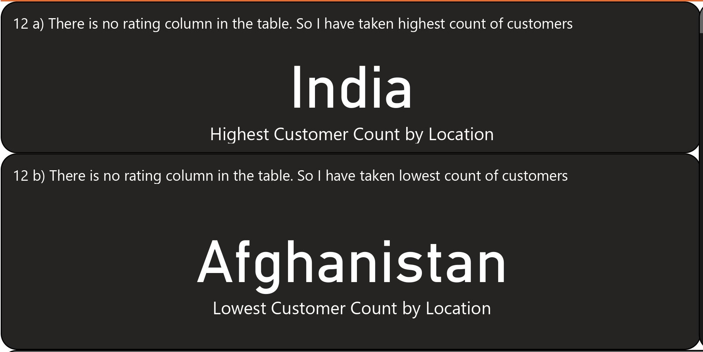
12) Which locations have the highest and lowest customer ratings?
Solution -
There is no column labeled “rating" in the table. Therefore, the count of customers customers is considered as rating. Hence, from the above visualization, we find India has the highest customer count and Afghanistan has the lowest customer count.

Slide 17
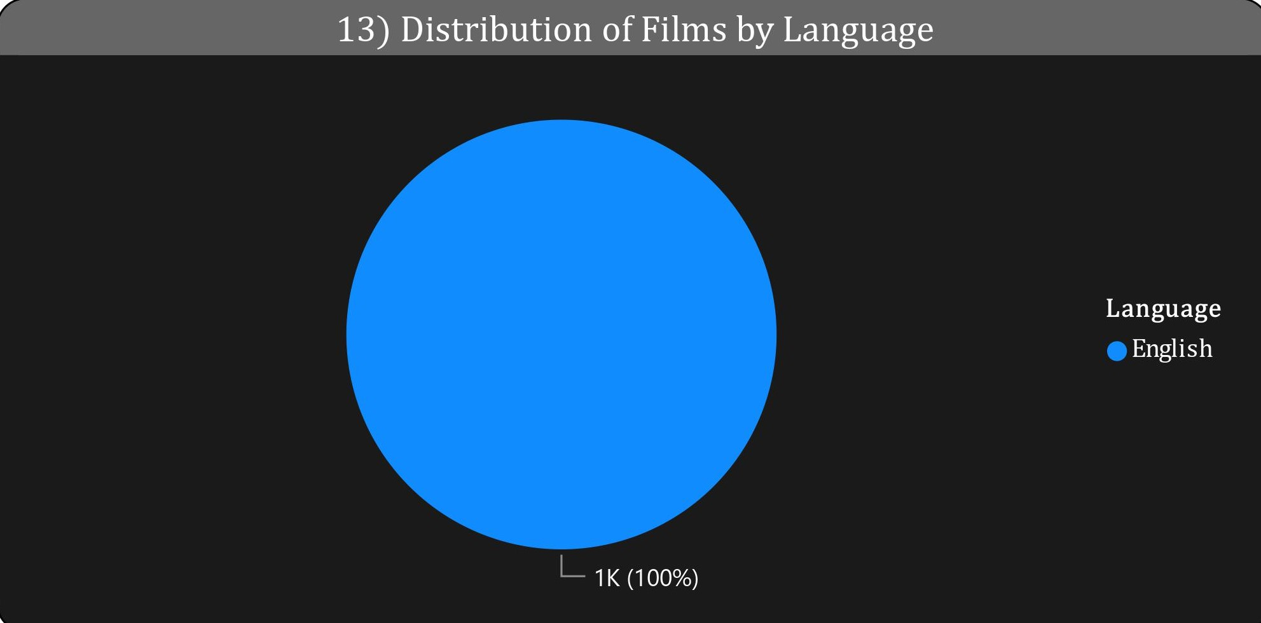
13) What is the distribution of films by language?
Solution -
From the visualization, it is clear that there is only one language film listed throughout the table, which is English language.

Slide 18
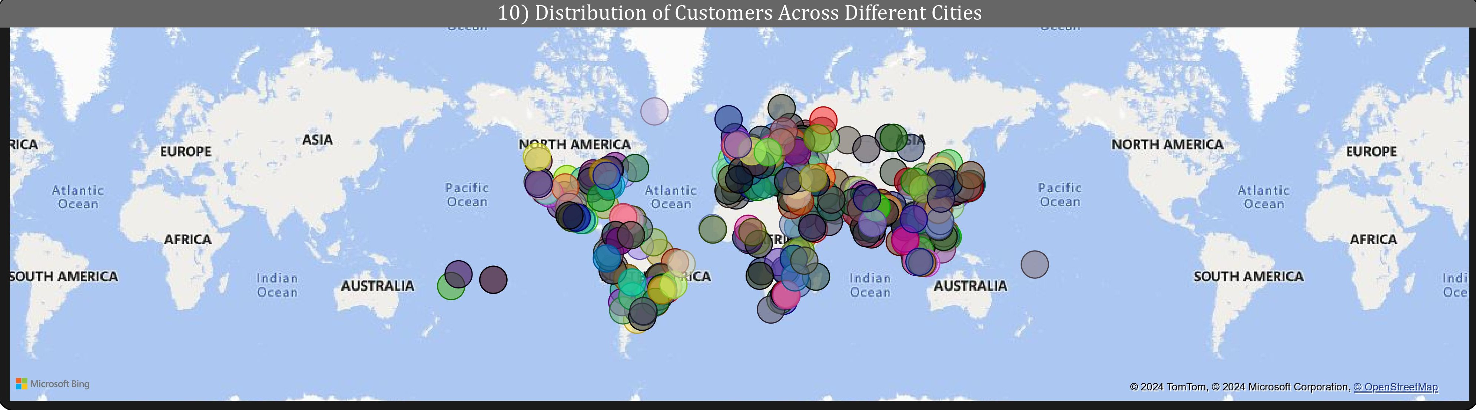
10) What is the distribution of customers across different cities?
Solution – From the above, every city highlighted in the legend has an equal number of customers. This shows that there are no common individuals across the cities in the table.

Slide 19
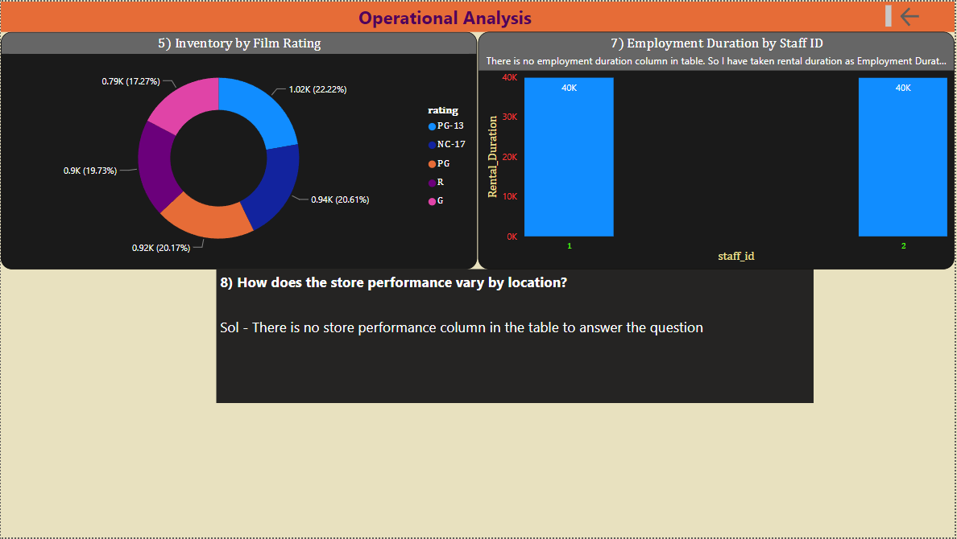

Slide 20
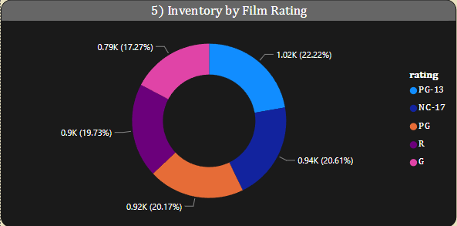
5) How does the inventory vary by film rating?
Solution -
From the visualization, it is clear thatPG-13 has highest inventory by film rating and G has the lowest.

Slide 21
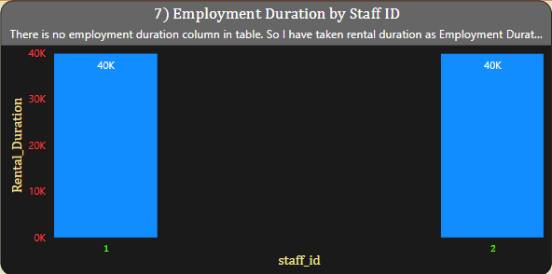
7) What is the distribution of staff by employment duration?
Solution -
There is no "employment duration" column in the tables. So, I have used rental duration for the visualization. For both staff members, it shows an equal amount of rental duration for the rentals they sold.

Slide 22
EDA PROBLEM STATEMENTS

Slide 23
1) What are the purchasing patterns of new customers versus repeat customers?
Solution – There are no new customers to analyze in the data. The analysis is made for repeat customers below

Slide 24
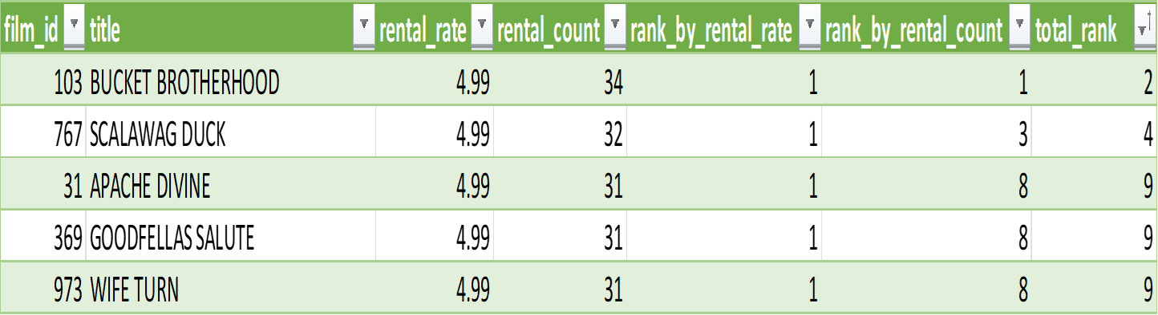
2) Which films have the highest rental rates and are most in demand?
Solution – From the table, we observe that "BUCKET BROTHERHOOD" has the highest rank in both rental rate and rental count (indicating high demand). Following "BUCKET BROTHERHOOD", "SCALAWAG DUCK" holds the second-highest rank, followed by "APACHE DIVINE", "GOODFELLAS SALUTE", "WIFE TURN", and "ZORRO ARK", which hold the third-highest rank.

Slide 25
3) Are there correlations between staff performance and customer satisfaction?
Solution – There is no staff performance and customer satisfaction column in the given tables to answer the question

Slide 26
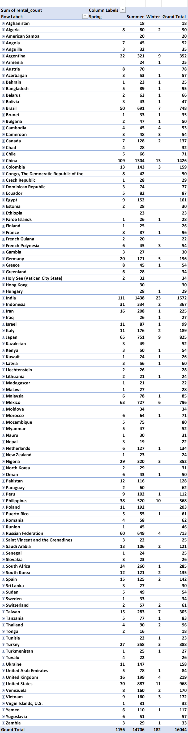
4) Are there seasonal trends in customer behavior across different locations?
Solution – The pivot table on the left shows the seasonal trend of customer behavior across different locations. Predominantly, for every location, the summer season experiences the highest number of customers compared to other seasons in every location.

Slide 27
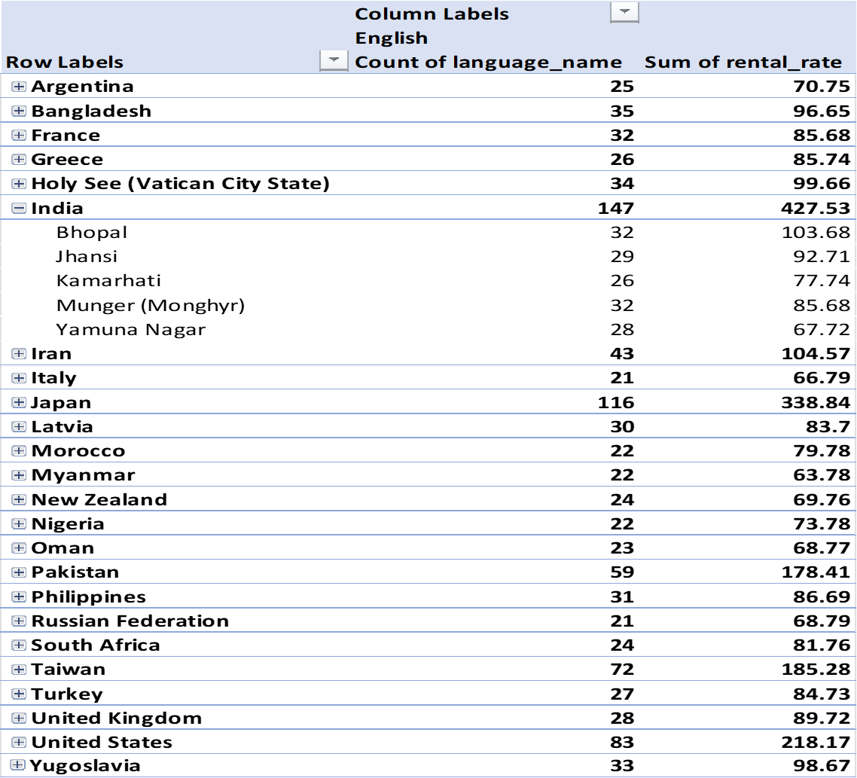
5) Are certain language films more popular among specific customer segments?
Solution – Considering country and city as customer segment factors, based on the pivot table, it's evident that individuals from India favor English-language films more than those from other countries. Moreover, in India, Bhopal stands out as the city with the highest number of English movie rentals.

Slide 28
6) How does customer loyalty impact sales revenue over time?
Solution – There is no column called "sales revenue" in the table. So, the amount paid in the payment table is considered as the sales revenue for this question. From the graph, we can conclude that until July 2005, there is an increase in revenue generated, but suddenly, there is a fall from July 2005 to August 2005, and from then, there is a big drop in February 2006.

Slide 29
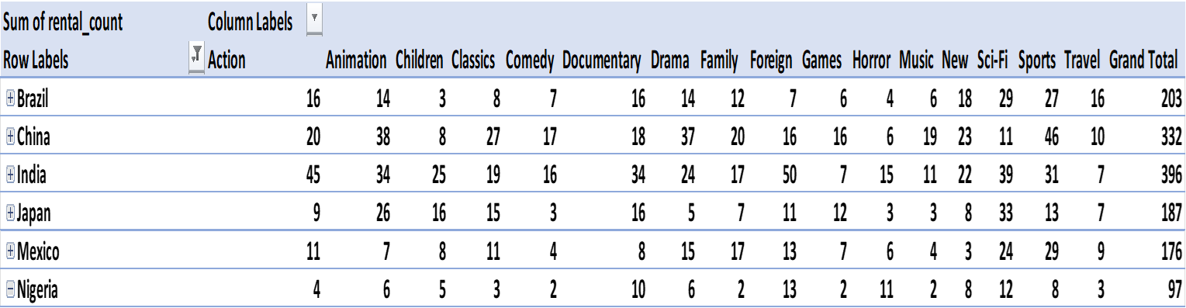
Solution – The table displays data for top 5 countries where the rental count is highest, indicating the most popular Category.
7) Are certain film categories more popular in specific locations?

Slide 30
8) How does the availability and knowledge of staff affect customer ratings?
Solution – There is no customer rating column in the given tables to answer the question

Slide 31
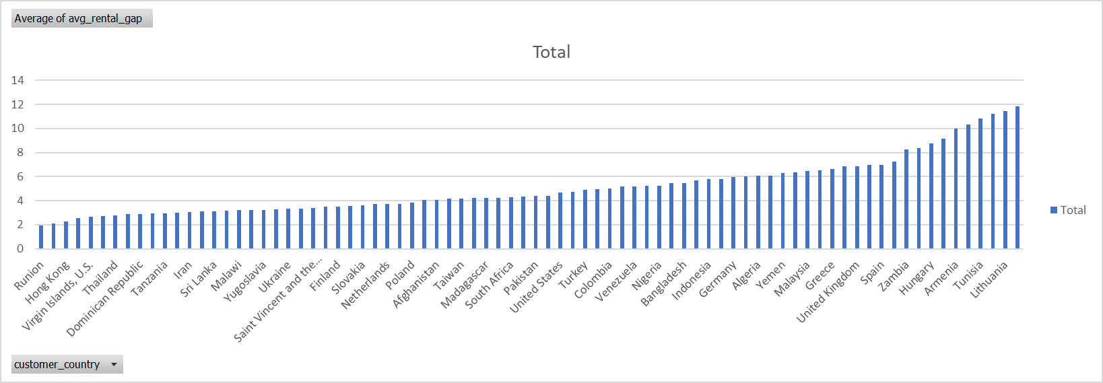
9) How does the proximity of stores to customers impact rental frequency?
Solution – There is no specific column called distance mentioned in the table to directly calculate the proximity. Therefore, the location parameter is taken as the country for finding the effect of frequency. For Canada as the store location, the average rental gap between one purchase and another is 2 days for Réunion, which is the least, and 12 days for Cameroon, which is the highest. Similarly, for Australia as the store location, it is 2 days for Bangladesh, which is the lowest, and 17 days for Israel, which is the highest.
However, we cannot accurately conclude the exact effect of proximity with the above findings. For instance, from Réunion, it takes around 17 hours to Canada, but the average gap is low. Conversely, from Cameroon to Canada, it takes 20 hours, but the average gap is high. The same holds true for Australia. Perhaps we can conclude that there is no significant effect of proximity, but further investigation is necessary.

Slide 32
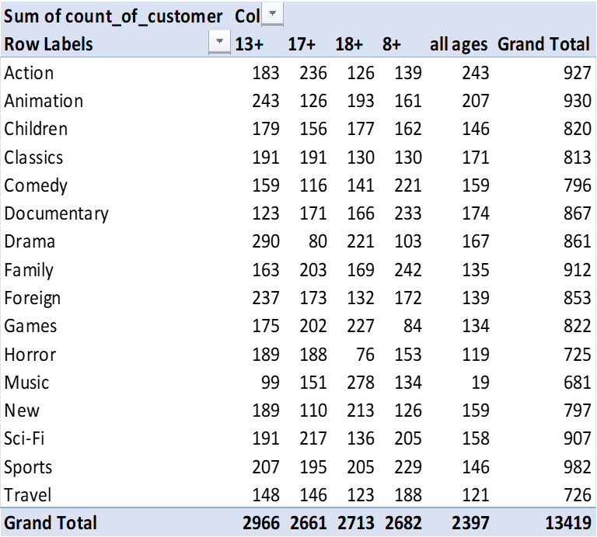
10) Do specific film categories attract different age groups of customers?
Solution – There is no specific column called “age” in the table to distinguish between age groups. So, ratings column is used to find out several age groups. Customers don't only like one type of movie, but one type seems to be the favorite. But that doesn't mean they don't watch other types. Let's say, for example, that people over 13 are mostly watching Drama movies. But they also watch horror, foreign, and animation movies. So we can see a trend, but we can't say for sure. This might change later. Right now, Drama movies are popular among people over 13. And other age groups might have different favorite types of movies.

Slide 33
11) What are the demographics and preferences of the highest-spending customers?
Solution – Top 10 filters was applied in the pivot table which was retrieved from SQL Query-1 to find out the top 10 customers whose sum of payment is greater and arranged in descending order. The numerical analysis is done in the below pivot table and further analysis is done in the table below to the pivot table which was retrieved from SQL Query-2

Slide 34
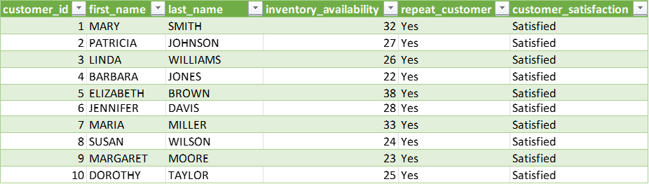
12) How does the availability of inventory impact customer satisfaction and repeat business?
Solution – There is no customer satisfaction column to directly answer this question. To evaluate inventory availability, data from film, inventory, and rental tables are combined to assess active rentals per film. Grouping by film, available inventory is calculated, crucial for understanding the tie between customer satisfaction and inventory. Customer satisfaction is determined by the ratio of unique inventory items rented to total rentals per customer. Repeat customers are identified by multiple purchases. From the analysis we can conclude the following: All inventory availability above 15 indicates repeat customers with good customer satisfaction.

Slide 35
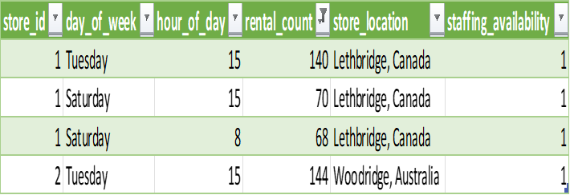
13) What are the busiest hours or days for each store location, and how does it impact staffing requirements?
Solution – It seems like having only one staff member available at each store location might not be sufficient during the busiest hours. For example, on Tuesdays at 3 PM in Canada, if there are 140 rental transactions happening, it's impossible for a single person to handle them all. This could result in server crashes, data mishandling, and a lot of errors. Both Australia and Canada experience higher rental counts around 3 PM on Tuesdays. It would be wise to increase staff during those peak hours to reduce errors. Additionally, Tuesdays and Saturdays are the most frequent days for high rental activity in the top 10 busiest hours for both locations. Therefore, it's advisable to increase staff, at least during those days, but it's not necessary to do so for the remaining days.

Slide 36
14) What are the cultural or demographic factors that influence customer preferences in different locations?
Considering film category factor: For the top 3 countries, Drama, Children, New are the most attracting genres among the other genres

Slide 37
14) What are the cultural or demographic factors that influence customer preferences in different locations?
Considering rating factor: Considering ratings, for every country, PG-rated movies have the highest number of purchases compared to any other rated movies.

Slide 38
15) How does the availability of films in different languages impact customer satisfaction and rental frequency?
Solution - There is no column called customer satisfaction to directly answer this question. Customer satisfaction is determined based on the average rental frequency. If a particular customer's average rental frequency is lower than the overall average, they are considered satisfied. Otherwise, they are deemed dissatisfied. Rental frequency is calculated as the difference in days between consecutive purchases. Since only English films are available, it is not possible to directly assess the impact of language on rental frequency and customer satisfaction.

